Slide 1
UNIT 2
Special casting process
Processing of plastics

Slide 2
SHELL MOULDING

Slide 4
CO2 MOULDING

Slide 5
INVESTMENT CASTING

Slide 6
PERMANENT MOULD CASTING

Slide 7
DIE CASTING

Slide 8
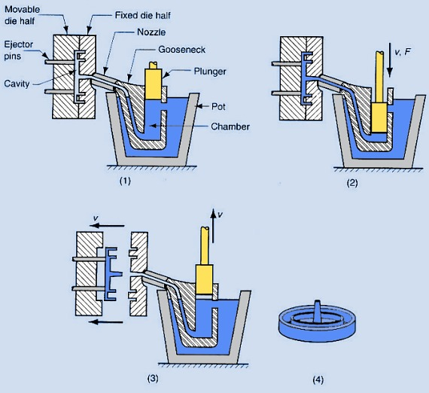
OPERATION SEQUENCE

Slide 9
OPERATION SEQUENCE COLD CHAMBER

Slide 10
CONSTRUCTION OF COLD CHAMBER

Slide 11
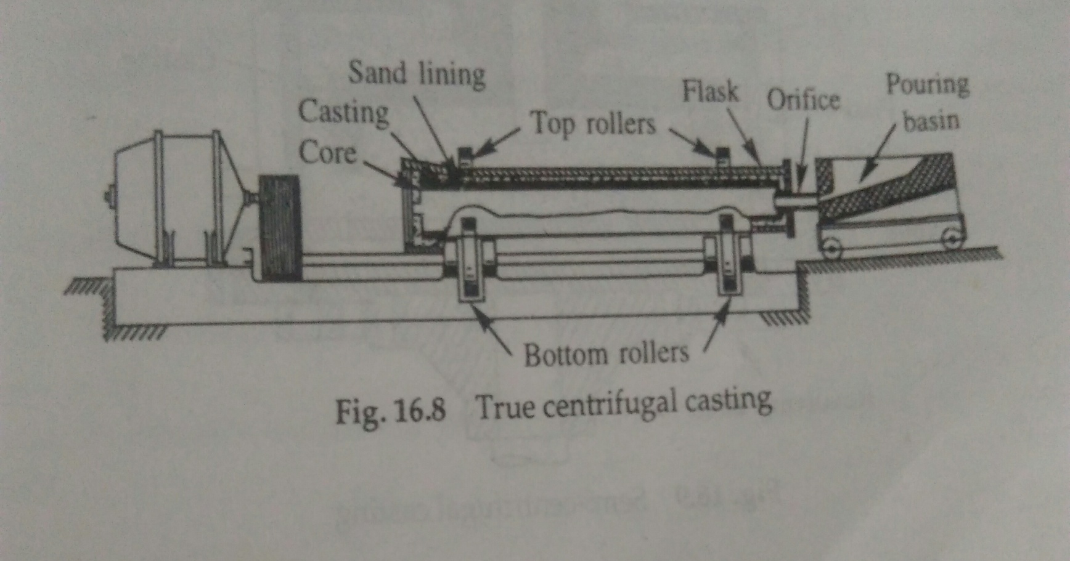
CENTRIFUGAL CASTING
TRUE CENTRIFUGAL CASTING

Slide 12
SEMI CENTRIFUGAL CASTING

Slide 13
CENTRIFUGING

Slide 14
PROCESSING OF PLASTICS

Slide 15
PLASTIC EXTRUDER

Slide 17
INJECTION MOULDING

Slide 19
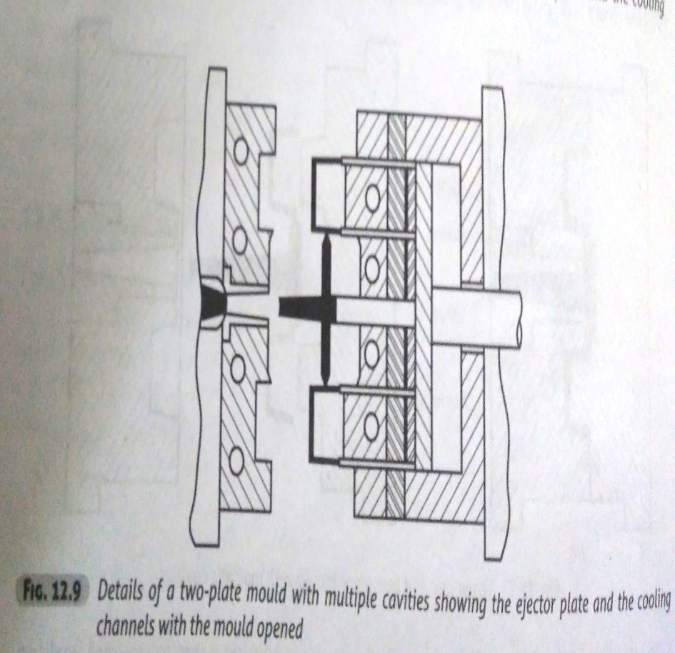
2 PLATE MOULD WITH SINGLE CAVITY

Slide 20
3 piece plate

Slide 21
AUTOMATIC PLASTIC PROCESSING

Slide 22
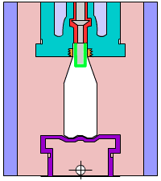
Extrusion blow moulding

Slide 23
Injection Blow moulding

Slide 24
Stretch Blow moulding

Slide 25
BLOW MOULDING

Slide 26
THERMO FORMING Vacuum thermoforming

Slide 27
VACUUM THERMOFORMING

Slide 28
PRESSURE THERMOFORMING

Slide 29
Pressure thermoforming

Slide 30
DRAPE FORMING

Slide 31
DRAPE FORMING

